Slide 1

States of The Unions: Presidential speech analysis
Metis Project 4: Unsupervised Learning
By: Gabriel Vieira Equitz Presented: February 25, 2021

Slide 2
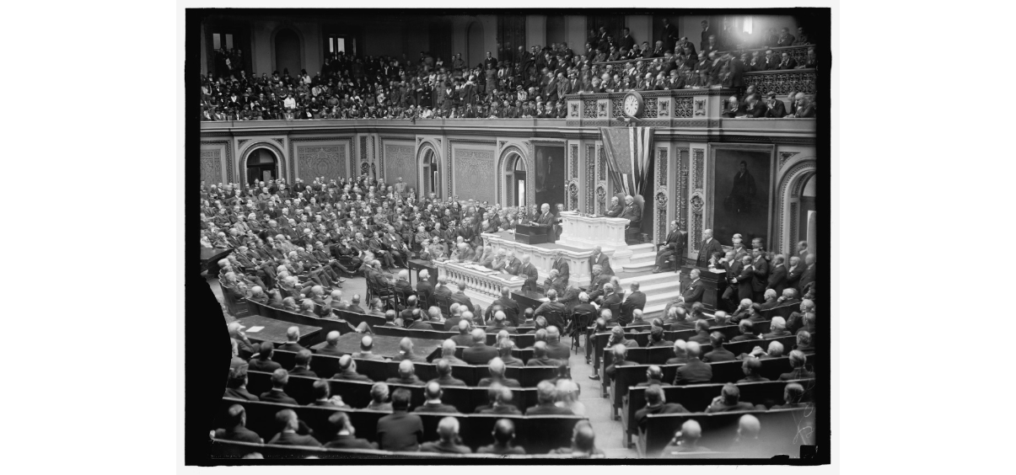
State of the Union addresses 1790-2018
Every year, since 1790, the President has given an address to Congress, talking about the condition of America and its people
All speeches until 2018: 228 total
from Washington (1790) to Trump (2018)
Notes:
Until 1913, the State of the Union was only a written letter to Congress, not actually speech

Slide 3
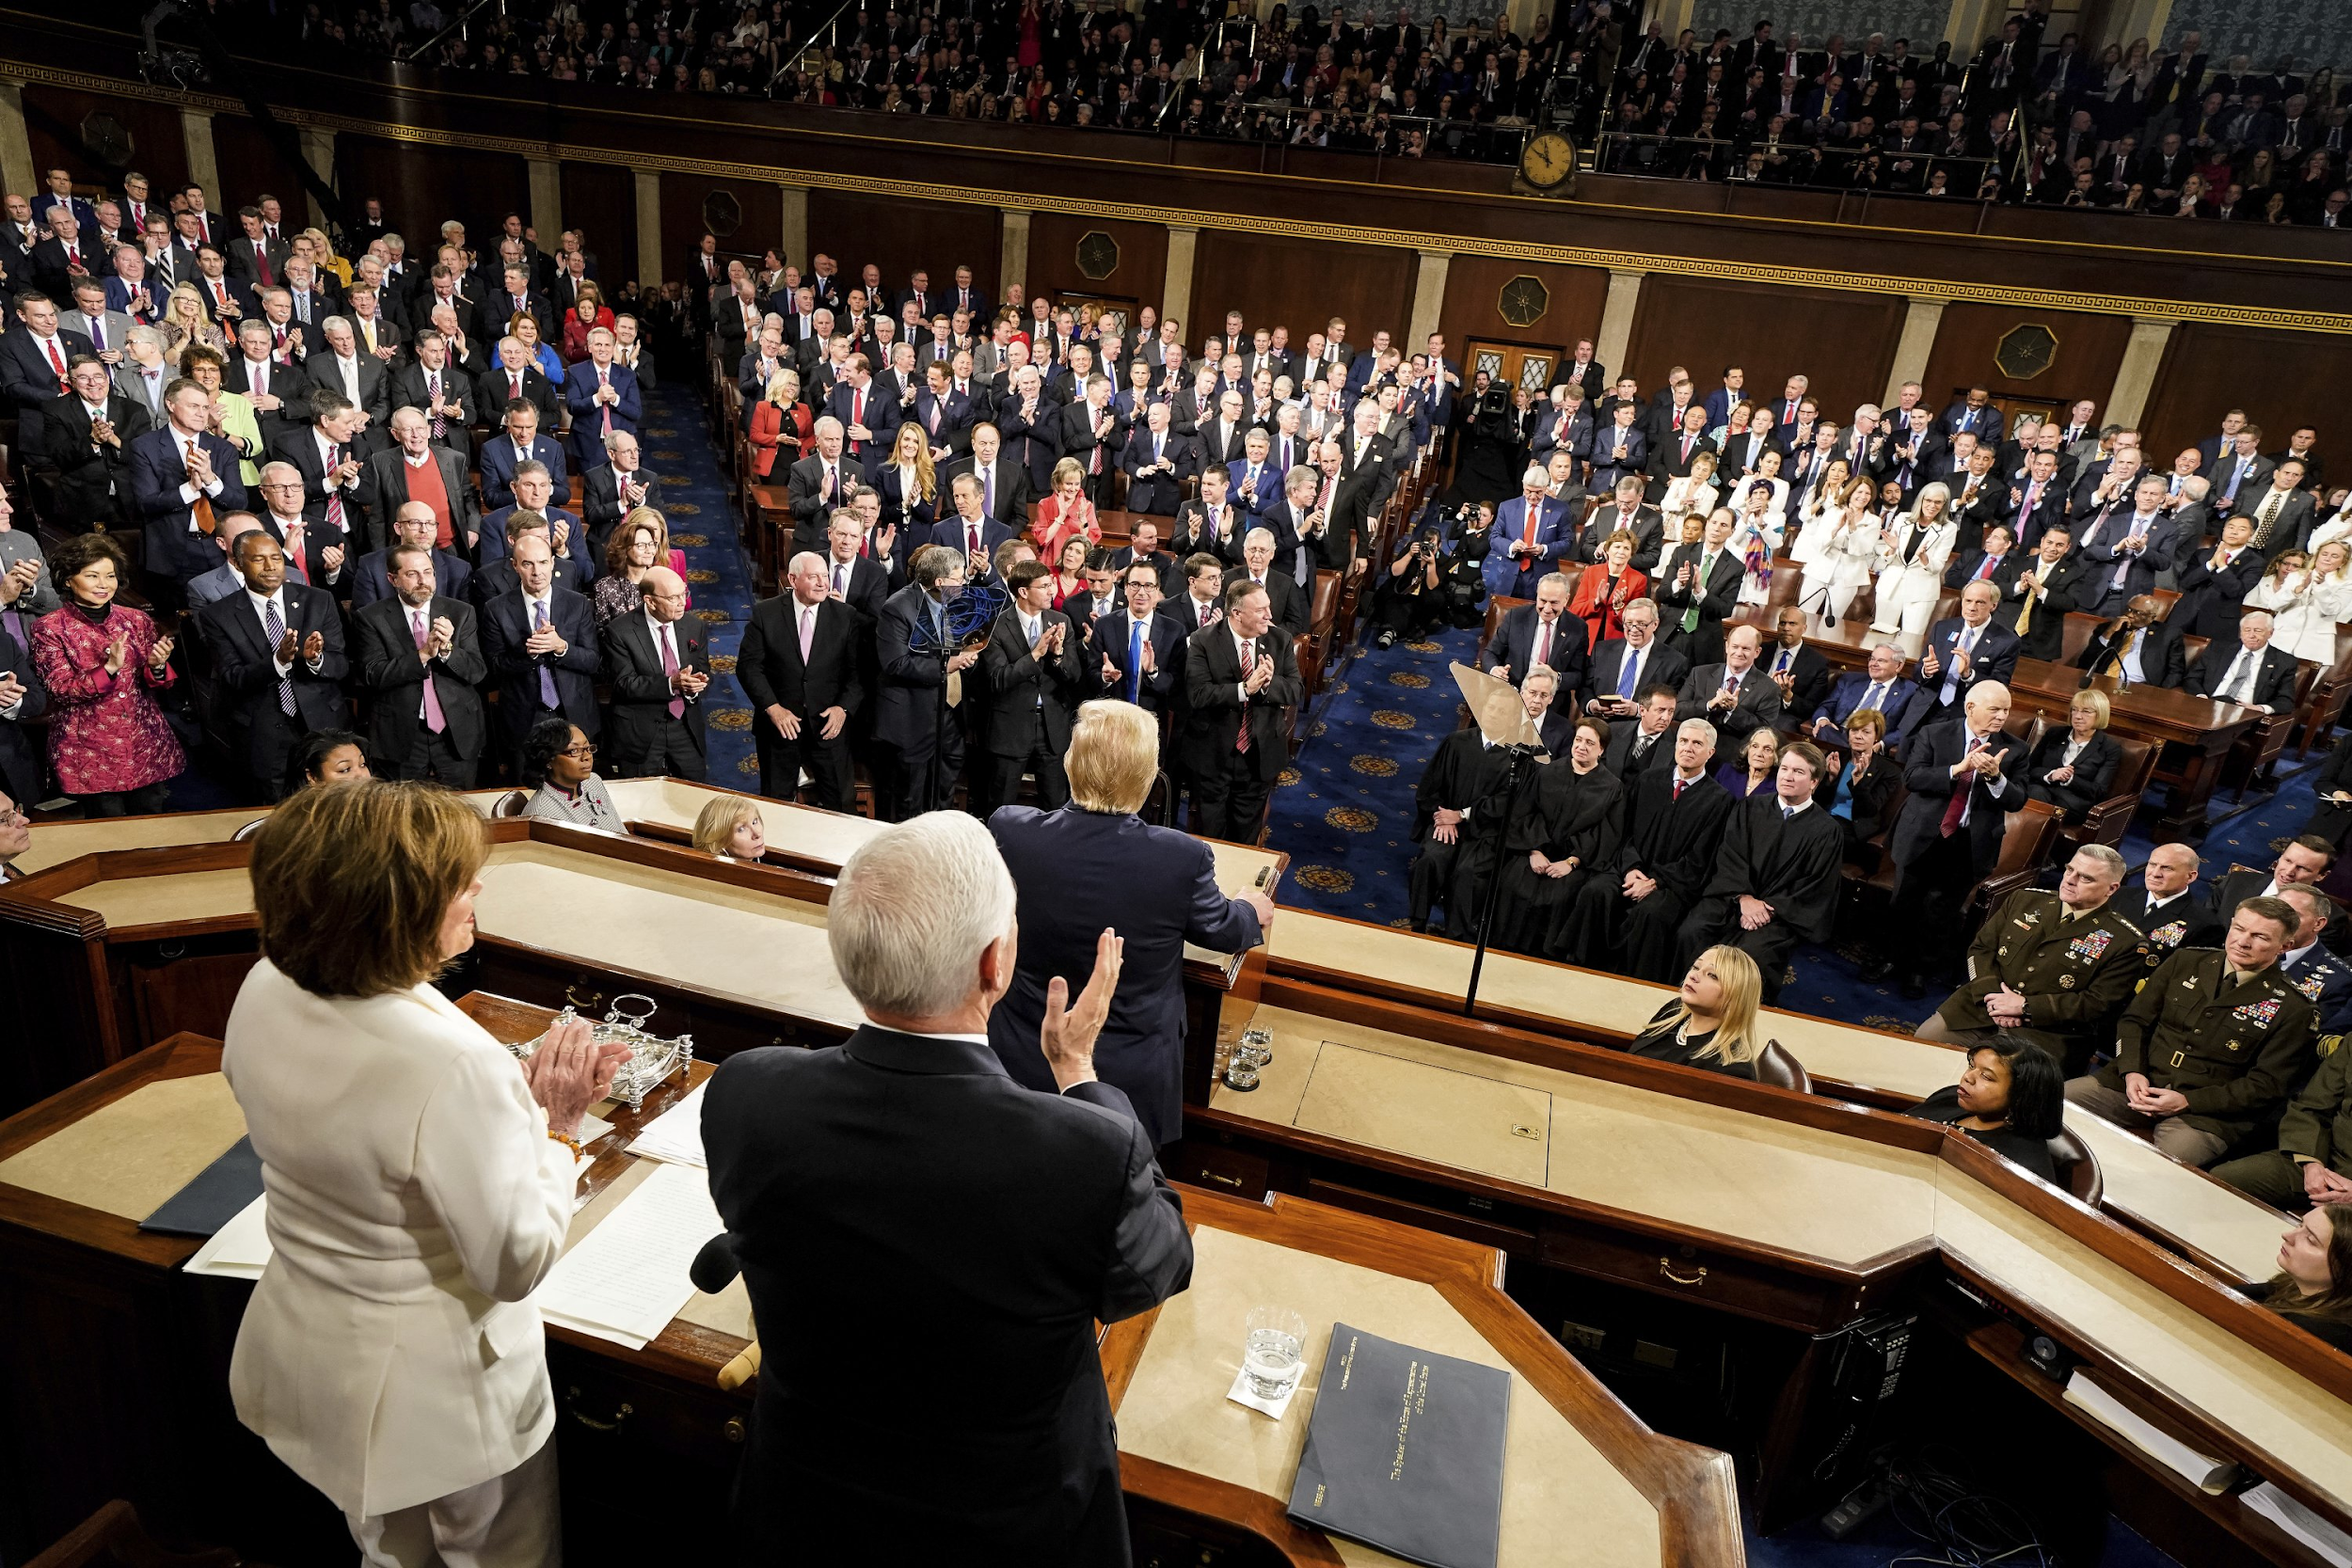
What we are trying to learn?
NLP can give us insights into the content of speeches, that humans may not otherwise get
Business case: See how topics change over time. People who are interested in American politics and want a deeper understanding of the first modern Democracy.
Includes politicians, economists, historians,
and you (hopefully)

Slide 4
How do we Process Natural Language (NLP)
Topic Modeling can be used for Unstructured Learning
Exclude common words (e.g. “Shall”, “America”, “People”) and outlier “words” (e.g. “aaa”, “(applause)”)
Max_df = 0.42
Min_df = 0.01

Slide 5
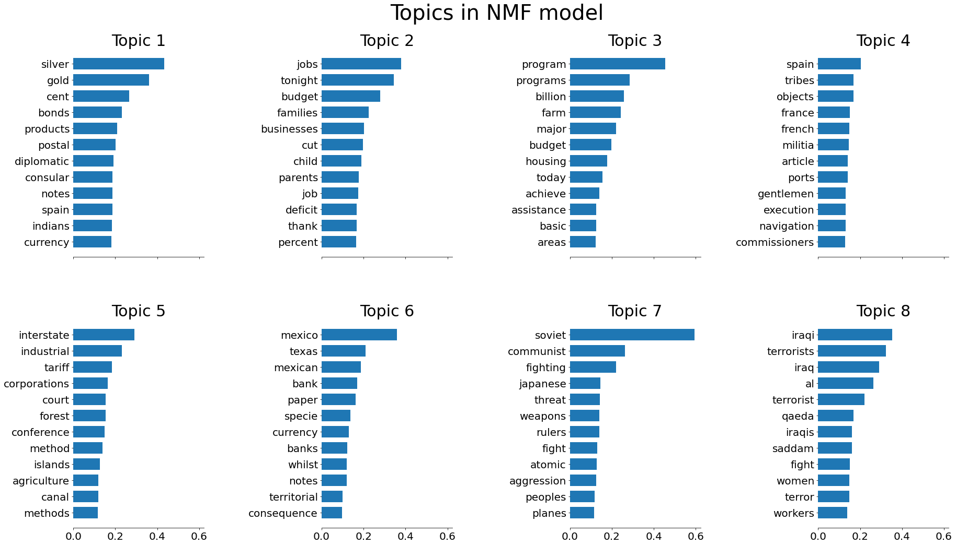
Topics
Using NMF, I narrowed down to 8 topics, and focused on the top 12 words of each topic

Slide 6
Groups
The 8 topics are further divided into 3 groups:
Topics 1 & 2: Economics
Topics 3 & 5: National Development (Industry & Gov’t Institutions)
Topics 4, 6, 7, 8: War and Foreign Policy

Slide 7
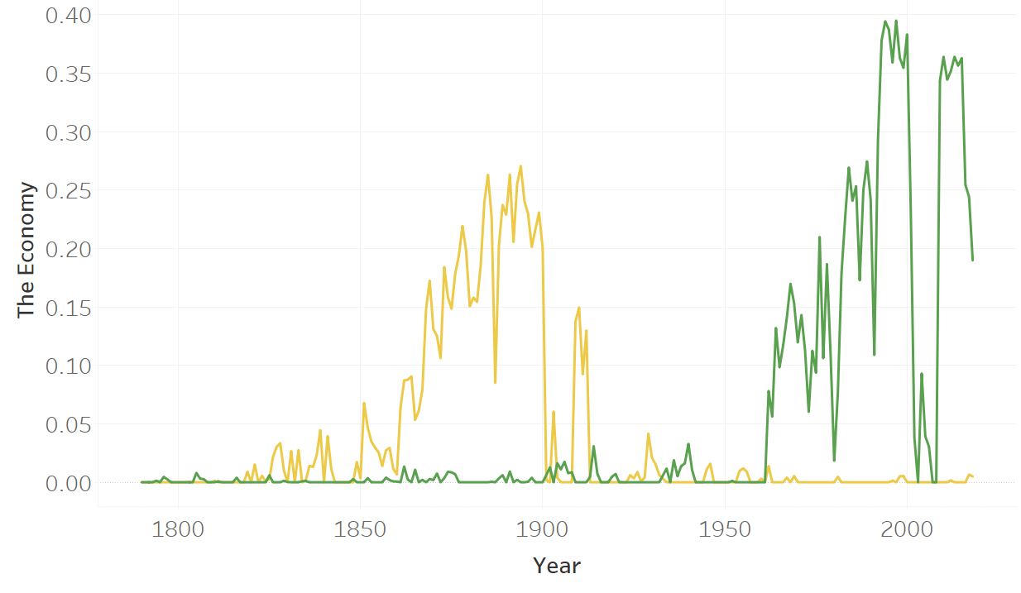
Topics 1 & 2: Economics Then & Now
Topic 1
19th Century Econ
(In Gold)
Topic 2
Modern Economics
(In Green)
Notes:
It not easy being green

Slide 8
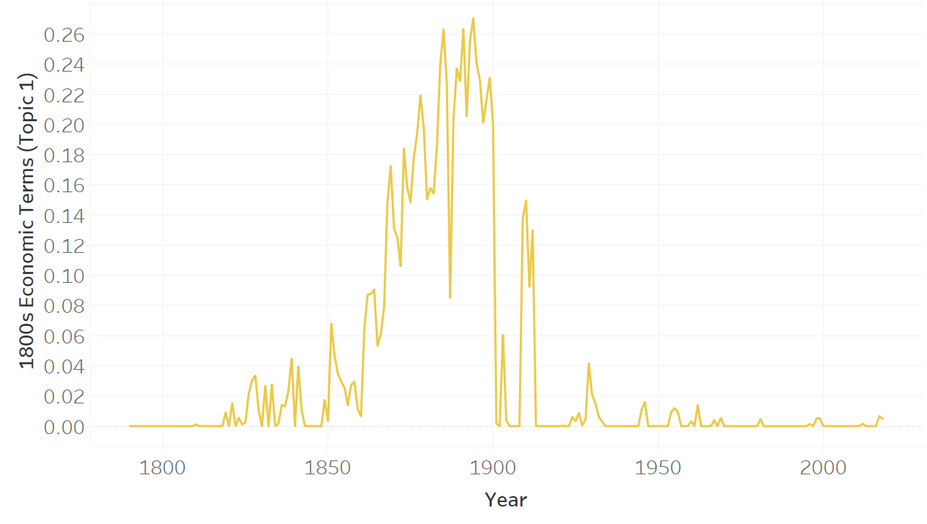
Topic 1: 19th Century Economic Language
Relevant words
Silver
Gold
Cent
Bonds
Notes
Currency

Slide 9
Topic 1: Economics Then
Topic 1 reflects economic language from the 19th century (peak is from 1869-1900, w/ resurgence under Taft 1909-1912)
Apparent Gold & Silver dominated late 1800s
(Bimetallism debate was big)
Terms like Cents, Bonds, and Notes are
less used today, showing how the
Presidential language used has changed

Slide 10
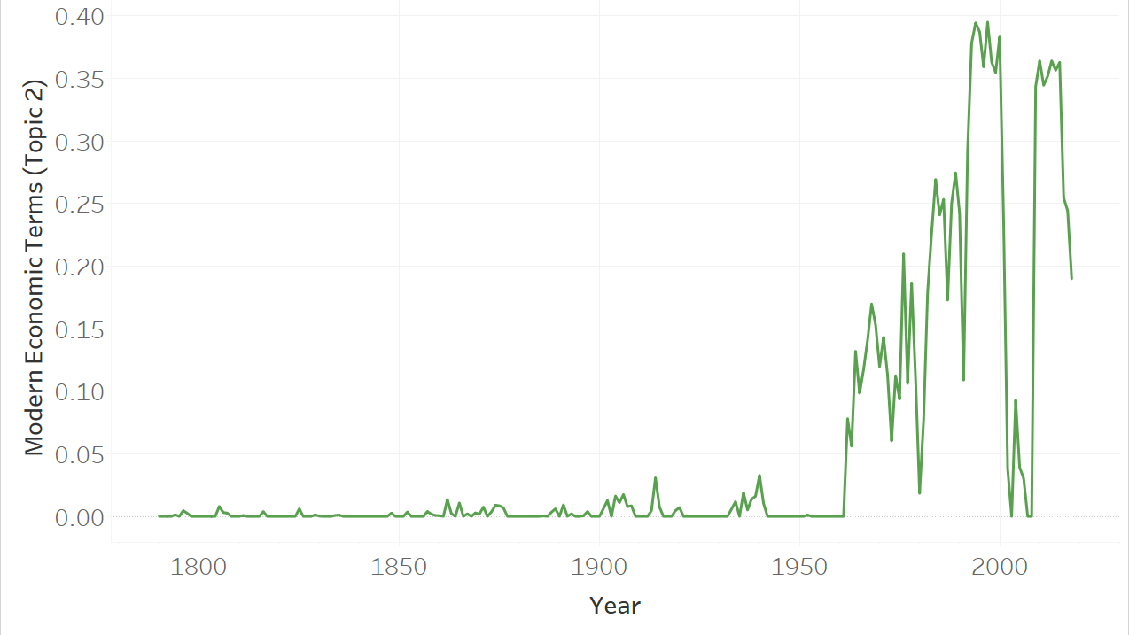
Topic 2: Modern Economic Language
Relevant Words
Jobs
Budget
Businesses
Cut
Job
Deficit

Slide 11
Topic 2 Economics Now
Topic 2 meanwhile shows how more recent presidents talked about the economy. In addition, presidents used words “Families”, “Child”, and “Parents” more
Topic 2 started rising under JFK in 1961.
Growth until peak w/ Clinton (1993-2000).
Sharp decrease in 2002 following 9/11.
Doesn’t rise again until Obama in 2009

Slide 12
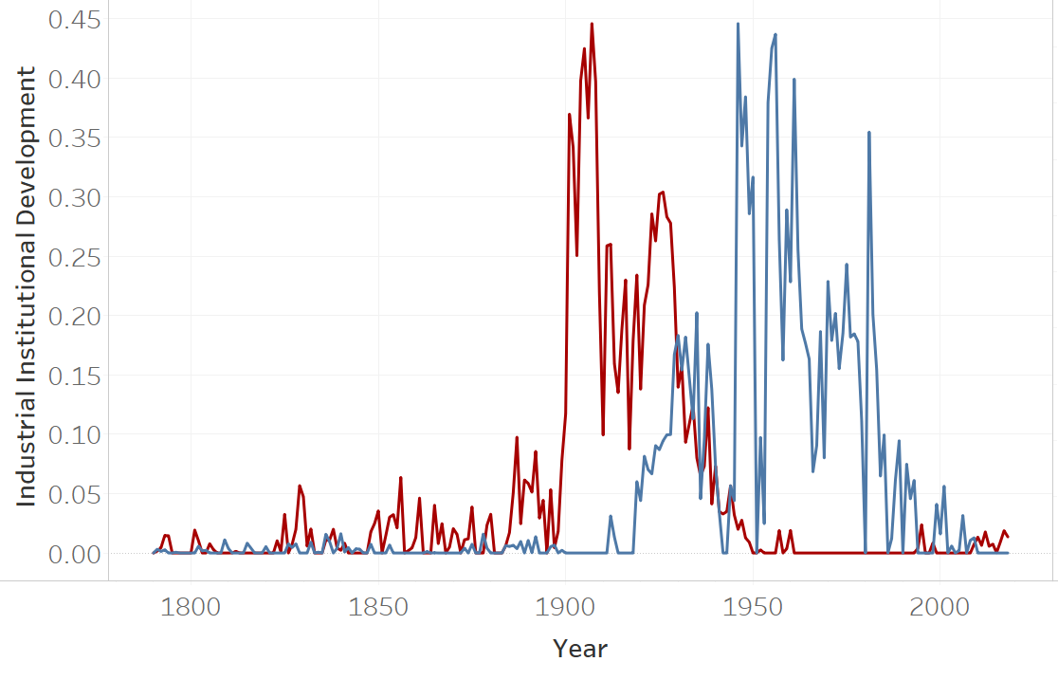
Topic 3 & 5:Industry Institution Development
Topic 5
19th Century Econ
(In Blue)
Topic 3
Modern Economics
(In Red)

Slide 13
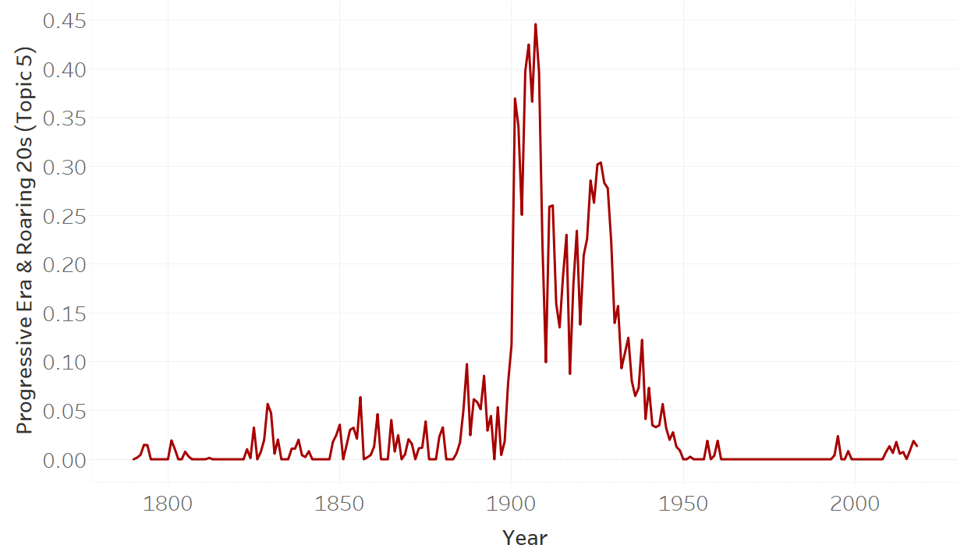
Topic 5: Progressive Era & Roaring 20s
Relevant Words:
Interstate
Industrial
Tariff
Corporations
Court
Canal

Slide 14
Topic 5: Industrial Revolution
Peaks in 1900-1930, Progressive Era & Roaring 20s
Represents the industrial revolution and
The rise of capitalism and increased trade
Moderate pause during WW1
Fizzles out in 1930, Great Depression
Correlation with relatively high peace

Slide 15
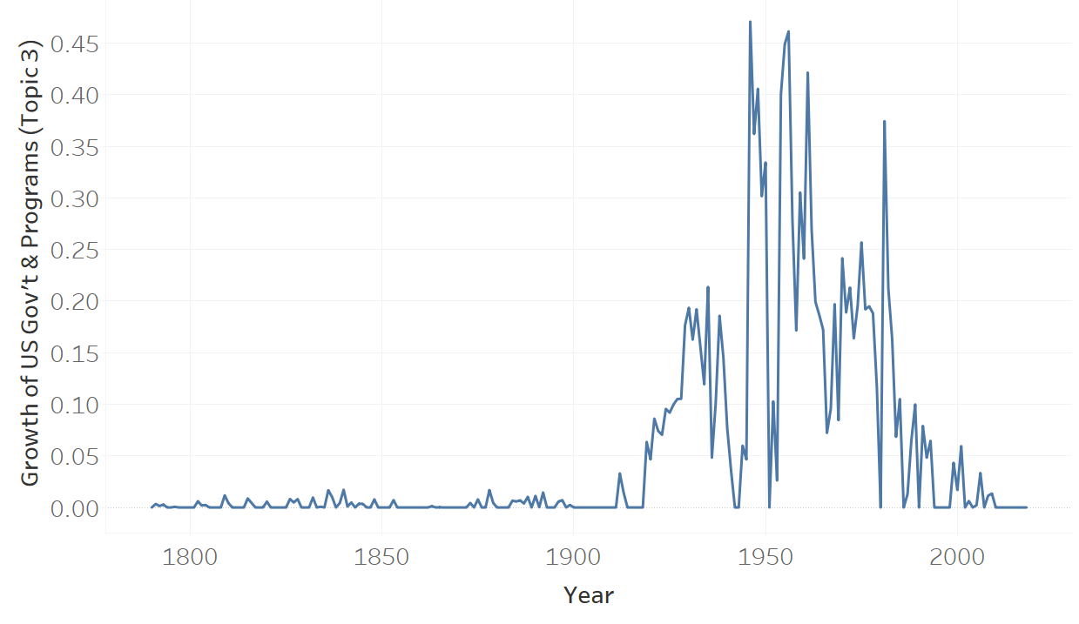
Topic 3: Growth of US Gov’t (+Departments)
Relevant Words:
Program
Programs
Farm
Budget
Housing
Assistance

Slide 16
Topic 3: More Public Programs
This represents the creation and expansion of federal welfare programs
Early peak correlates w/ New Deal (1930s)
Apex under Truman, Eisenhower (1946-1961)
After WW2
Lowers until Reagan, in which this topic is
More or less gone by his 2nd term (1984)

Slide 17
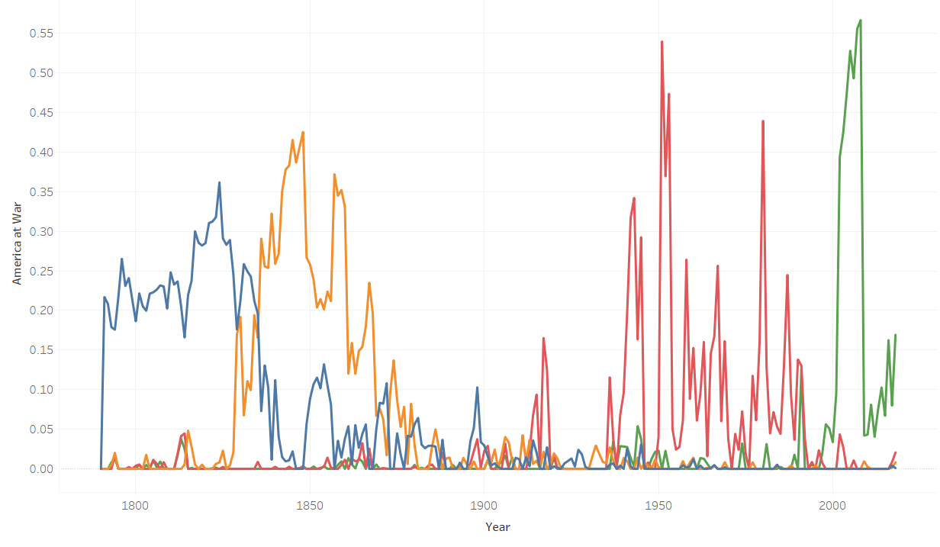
Topics 4/6/7/8: WAR! (and foreign policy)
Topic 4 Topic 6
1790-1830 1830-1880
(In Blue) (In Gold)
Topic 7 Topic 8
1940-1990 2002-now
(In Red) (In Green)

Slide 18
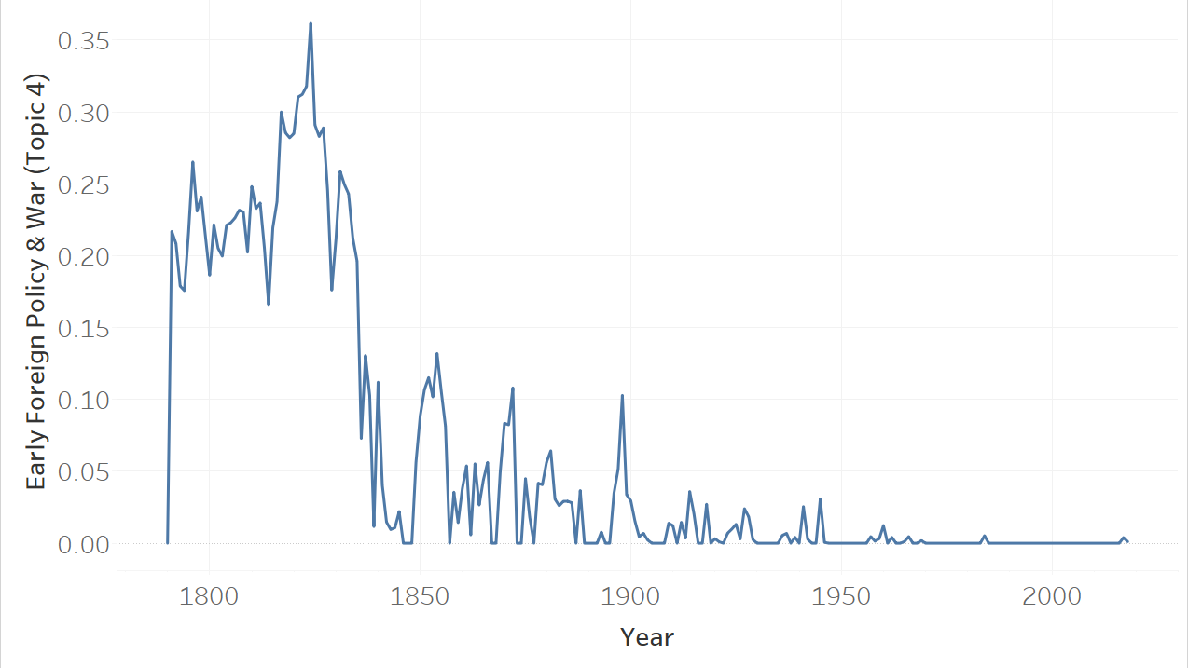
Topic 4: Early Foreign Policy & War
Relevant Words:
Spain
Tribes
France
Militia
Execution
Commissioners

Slide 19
Topic 4: Olde War (1790-1830)
These words reflect the nature of war and foreign policy in the times of the founding fathers
The US bought land from the French and
Spanish. Took land from Native Americans
Militia, Commissioners and other such
Terms are almost never in SoTUs now
(refers to lack of standing army)

Slide 20
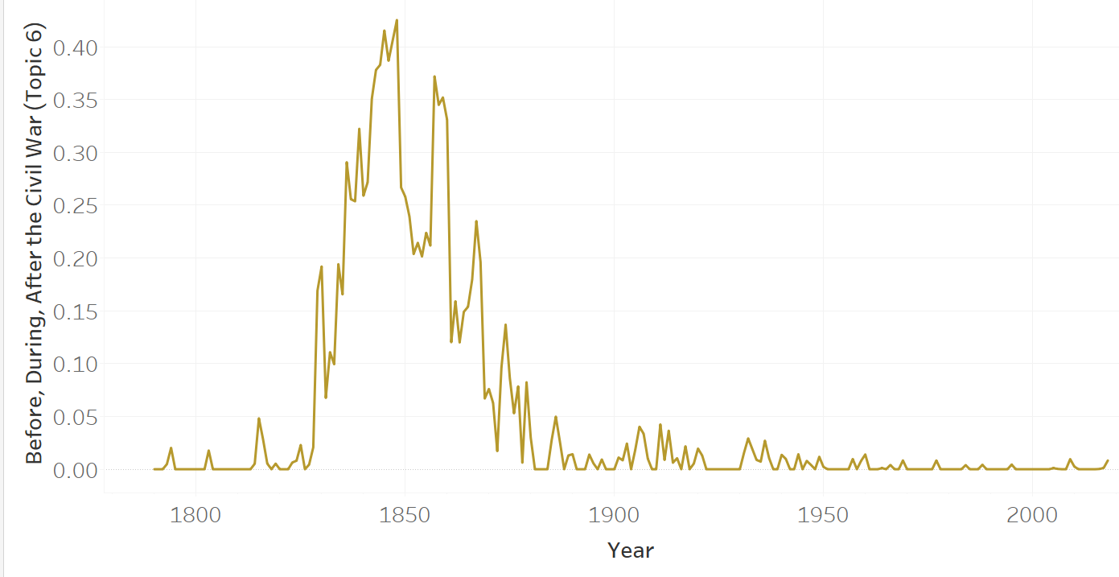
Topic 6: 1830-1880 in War
Relevant Words:
Mexico
Texas
Mexican
Territorial
Consequence

Slide 21
Topic 6: Before, During, After the Civil War
This topic highlights the period from 30 years before the US Civil War to 15 years after
Starts with Jackson (1830), but peaks
in Mexican-American War (1846-1848)
Remains high through Civil War, and
Basically ends with Reconstruction
(end of US military occupation of South)

Slide 22
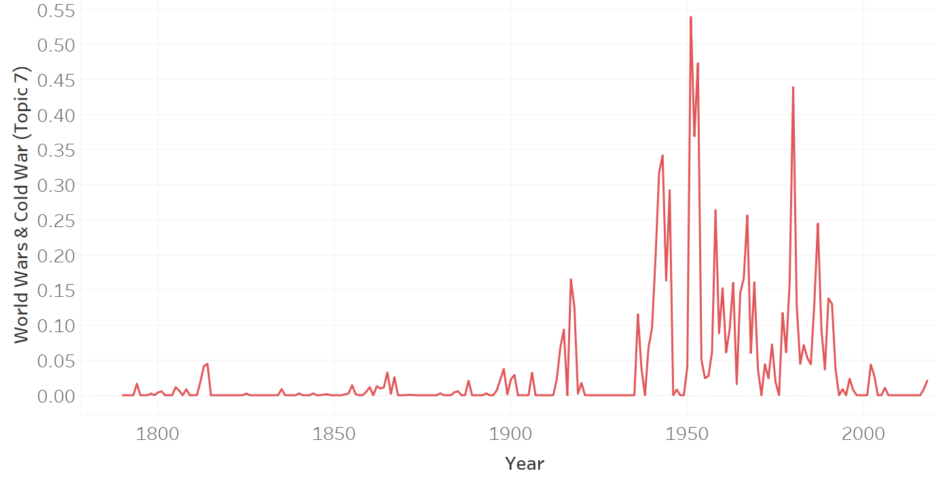
Topic 7: World Wars & Cold War
Relevant Words:
Soviet
Communist
Fighting
Japanese
Atomic
Aggression

Slide 23
Topic 7: War has changed, Again
We see references to a new world order and new technologies
Massive spike a response to escalation of
Cold War (Russia develops Nuclear bombs
And escalation of Korean War (1951)
End corresponds w/ fall of the USSR
(1990)

Slide 24
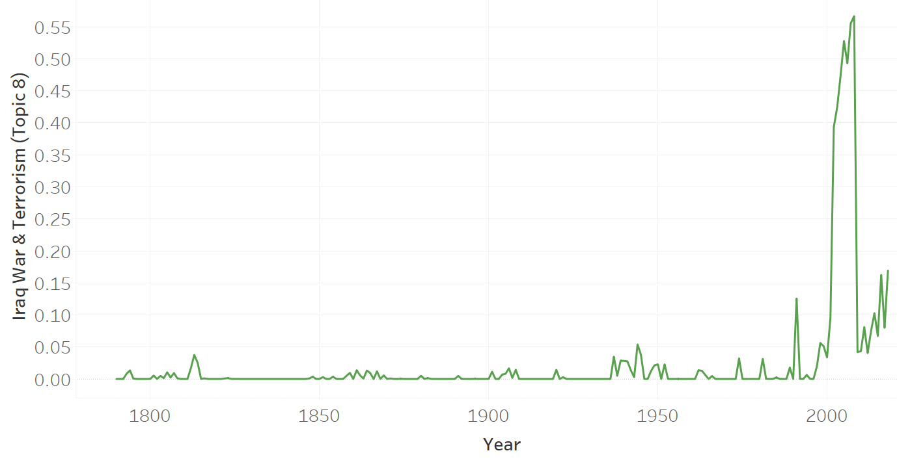
Topic 8: Iraq War & Terrorism
Relevant Words:
Iraqi
Terrorists
Qaeda
Saddam
Fight
Terror

Slide 25
Topic 8: This is Modern War
The aftermath of 9/11 and the Iraq War defined the presidency of George W. Bush
2001 speech is Topic 2, but Topic 8
Dominates 2002-2008
Rise w/ Bush Sr, Gulf War (1991)
Somewhat increases w/ ISIS (2014-)

Slide 26
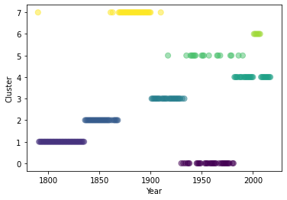
Scatter Plot
Correspond to largest topics for each
speech/year

Slide 27
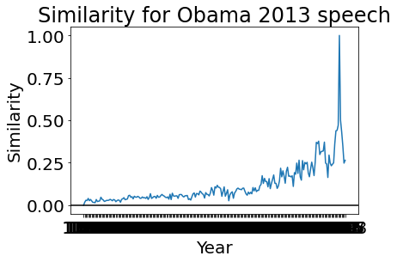
Most Similar Speeches
The most similar speeches, when not by the same president, are typically those of their immediate predecessors and successors.
Obama is an exception: His speeches are
Most similar to Clinton

Slide 28
Conclusions
Topics 1 & 2 show how presidents State of the Union speeches have changed in regards to economics (less Silver & Gold, more Jobs & Budgets now)
Topics 3 & 5 show how language on industry and government institutions have evolved with the industrial revolution and increased size of the US gov’t
Topics 4, 6, 7, 8 show how war has changed: Who is fighting, what are the technologies, and tactics
Also: 200 years ago, ‘gentlemen’ was a top word, now ‘women’ is a top word (Topic 8 Iraq)

Slide 29
Potential Future Work
Add and compare economic data (GDP/GNP)
Analyze by party, see if Democrats and Republicans switch in 1960s
Does American politics have 40 year cycles? (Schlesinger)
1780-1820, 1820-1860, ...1940-1980, 1980-2020

Slide 30
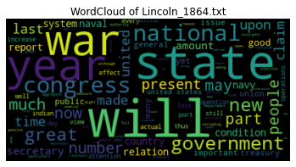
Addendum
Word Cloud!

Slide 31

The End

